Slide 1
OPENSHIFT
Jim Garrett
Senior Solution Architect
jgarrett@redhat.com
August 2018

Slide 2
Agenda
9:15 Start

Slide 3
Agenda
Container Discussion
See how Red Hat OpenShift Container Platform makes it easy to build containers from source code
Deploy sample applications on Red Hat OpenShift Container Platform

Slide 4
Introductions
Name
Role/Title
Experience/knowledge with Containers?

Slide 5
Goal – Answer These Questions
Who are the characters?
What is the problem?
What is the Setting?
How do you solve the problem?
What happens at the end, what do you get out of it?

Slide 6

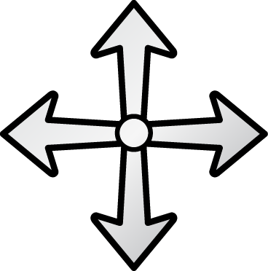
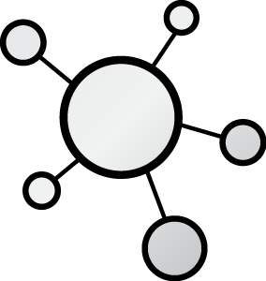
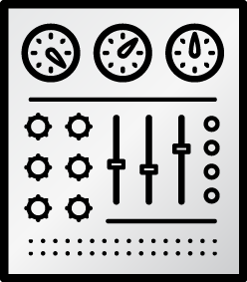

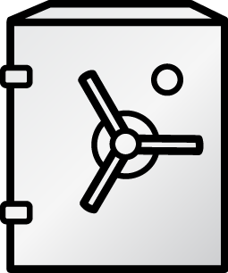







THE CHARACTERS
DEVELOPERS
I.T. OPERATIONS
Notes:
Developers have different motivations and concerns than the IT Operations.
Developer's job is to deliver a code
IT Operations’ job is to bring stability
Environment predictability
As a result, applications are designed and developed in accordance to Developers mindset and Operations requirements are layered over it at later stages of delivery, leading to frustrating frictions specially in the end of each delivery cycle.

Slide 7
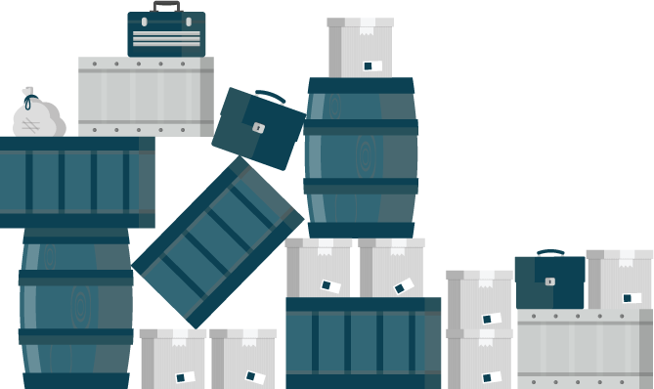
The Problem
Applications require complicated installation and integration every time they are deployed
Lots of Friction
Leads to poor quality of delivered service
Larger Deployments
Avoid pain by deploying less often
Notes:
Delivering an application into production is a non-trivial task
lots of friction and many back-and-forth cycles between Developers and IT Operations.
Painful deployments leads poor quality of the delivered service
Tendency to avoid the pain by deploying to production as seldom as possible.
Results in larger deployments with more features being delivered at once and higher risk of things going wrong, which results in more pain, fewer deployments, … and story goes on.

Slide 8
Top 10 Replies by Programmers
IT WORKS ON MY MACHINE!!!
Where were you when the program blew up?
Why do you want to do it that way?
You can’t use that version on your system!
Somebody must have changed my code!
It works but it hasn’t been tested.
I can’t test everything!
You must have the wrong version!!!
It’s never done that before!
That’s weird!

Slide 9
DEVOPS - Setting
Everything as code
Application monitoring
Automate everything
Rapid feedback
Continuous Integration/Delivery
Rebuild vs. Repair
Application is always “releaseable”
Delivery pipeline
Notes:
DevOps has Gained popularity in the last two years.
Many of the practices and values in DevOps aim at mitigating this problem described previously.
However implementing these practices proved to be extremely difficult using virtualization and other technologies which were available at the time.

Slide 10
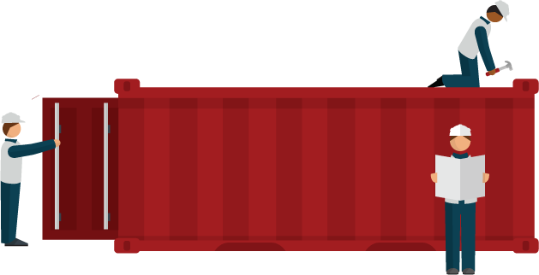
The Solution
Adopt a container strategy
Allows applications to be easily shared and deployed.
Simplifies the automation that DevOps provides
Provide consistent environment for Developers and Operations
Write once – deploy anywhere
Notes:
DevOps only took off when containers gained popularity
Simplifies the automation that DevOps provides.
Containers provide consistent environment and tools for both Developers and Operations
Simplify the deployment process regardless of what the application looks like
Recreate identical environments for development, testing, staging, and production
Write once; deploy anywhere

Slide 11

WHAT ARE CONTAINERS? It Depends Who You Ask
INFRASTRUCTURE
APPLICATIONS
Sandboxed application processes that run on a shared Linux OS kernel
SE Linux
Simpler, lighter, and denser than virtual machines
Portable across different environments
Package the application and all of its dependencies
Deploy to any environment in seconds and enable CI/CD
Easily access and share containerized components
Notes:
Infrastructure perspective
containers rely on Linux operating system features
isolate slices of the underlying operating system.
Has some libraries from Linux operating system inside it.
Consume less resources compared to virtual machines.
Pose complexities that need orchestration and management to be used effectively.
Application perspective
way to package an enterprise application in a self-contained artifact.
Simple to share those apps across the organization.
Developers have full control over the content of a container

Slide 12
THE SOLUTION
Container
App
Controlled by Developers
Operating System
Controlled by IT Operations
Virtual Machine
Hardware
Notes:
IT Operations controls
hardware, virtualization layer, operating system and make sure they are patched, secure and managed in accordance to their best practises.
know how to run containers effectively on top of that infrastructure to maximise utilisation.
Developers
control the application, frameworks and libraries used in the application and package that as a container which is delivered to IT Operations.
mitigates the traditional friction between the two teams in the software delivery process.

Slide 13


THE SOLUTION
DEVELOPERS
I.T. OPERATIONS
Notes:
The promise of containers is that everybody’s needs are fulfilled
teams can work together in better ways than previously they were able to.
In the eyes of many inside the organization, containers come to the rescue as the common language between Developers and IT Operations.
Containers can drive a revolutionary change into how these two sides of an IT organization work together;
allow developers and the line of business to own their applications in the form of containers that then can be deployed, maintained, and operated on top of infrastructure that the Ops team provides, without compromising security or compliance.

Slide 14
WE NEED MORE THAN JUST CONTAINERS
WE NEED ORCHESTRATION!!!
Scheduling Decide where to deploy containers
Security Control who can do what
Lifecycle and health Keep containers running despite failures
Scaling
Scale containers up and down
Discovery Find other containers on the network
Persistence
Survive data beyond container lifecycle
Monitoring Visibility into running containers
Aggregation
Compose apps from multiple containers
Notes:
Although building and running single containers on a host is fairly simple, build and running multi-container application across multiple infrastructure requires more than just containers.

Slide 15
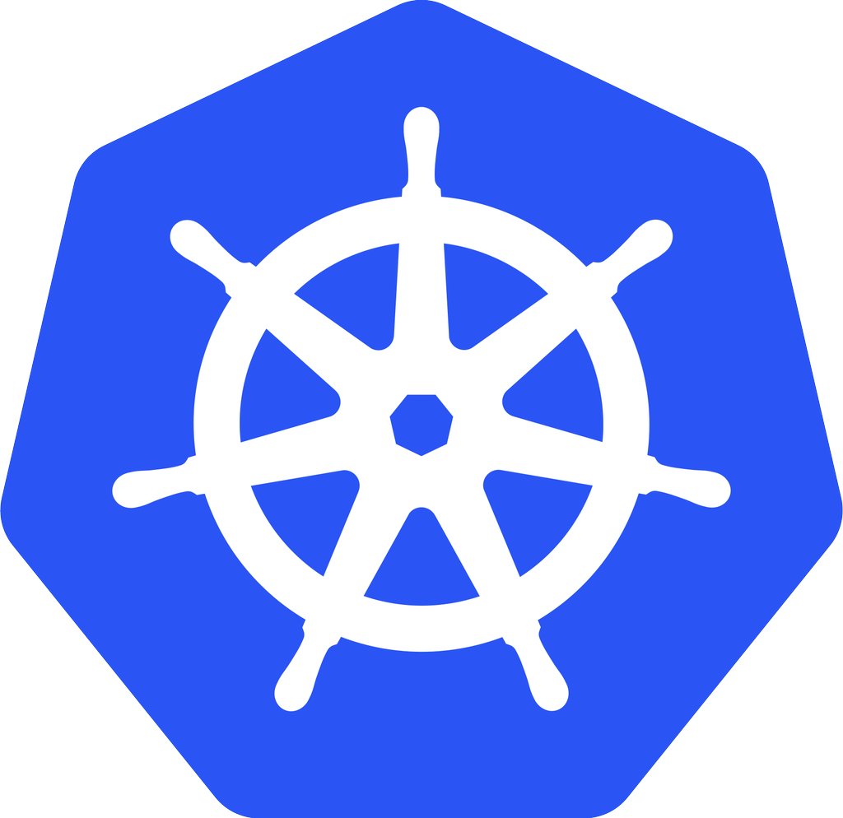
Kubernetes - open-source ORCHESTRATION framework
Developed by Google
Manages container lifecycle, health, scaling
Has its own Command Line Interface and API
Red Hat is THE top contributor to Kubernetes, after Google
kubernetes
Notes:
Kubernetes automates deployments of containers across the hosts
Kubernetes
open-source orchestration framework
developed by Google
manage the containers lifecycle, health, scaling, authentication, discovery and persistence.
15+ years of experience
Red Hat along with Google is the top contributor to the Kubernetes project.

Slide 16


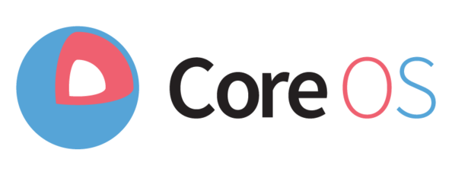

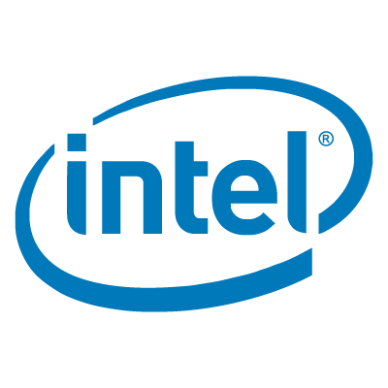
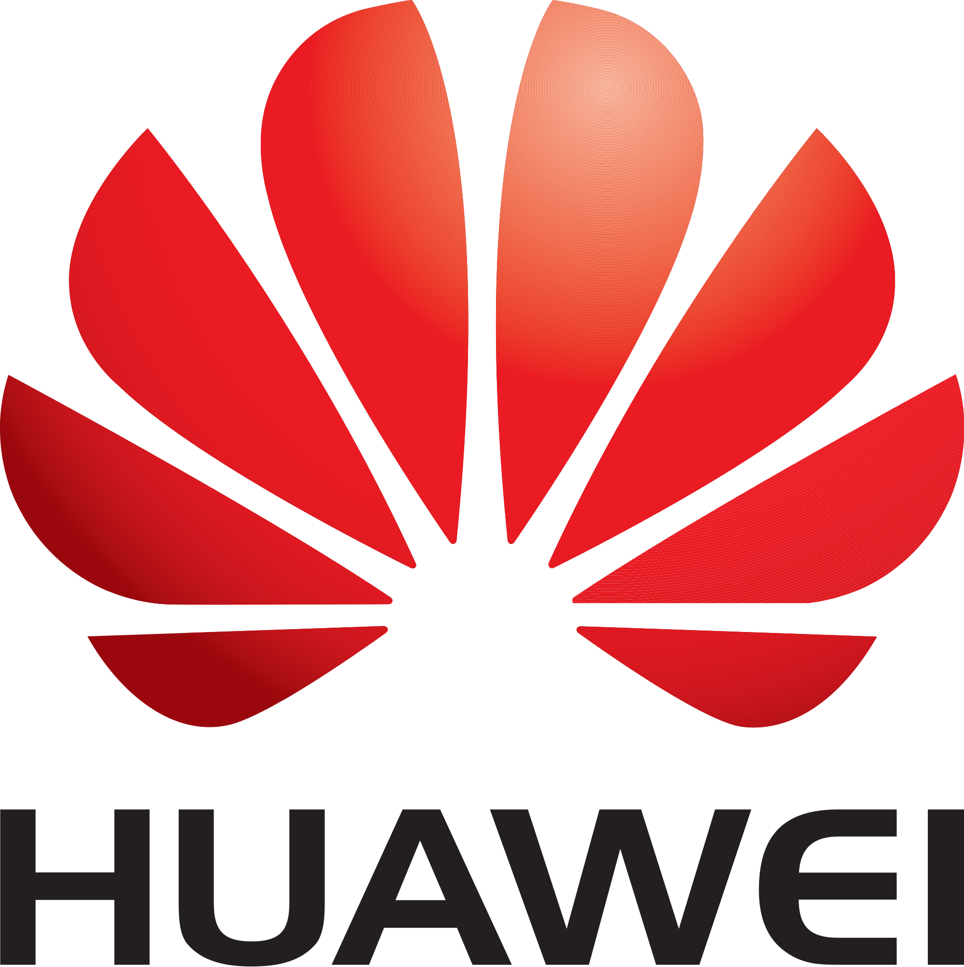
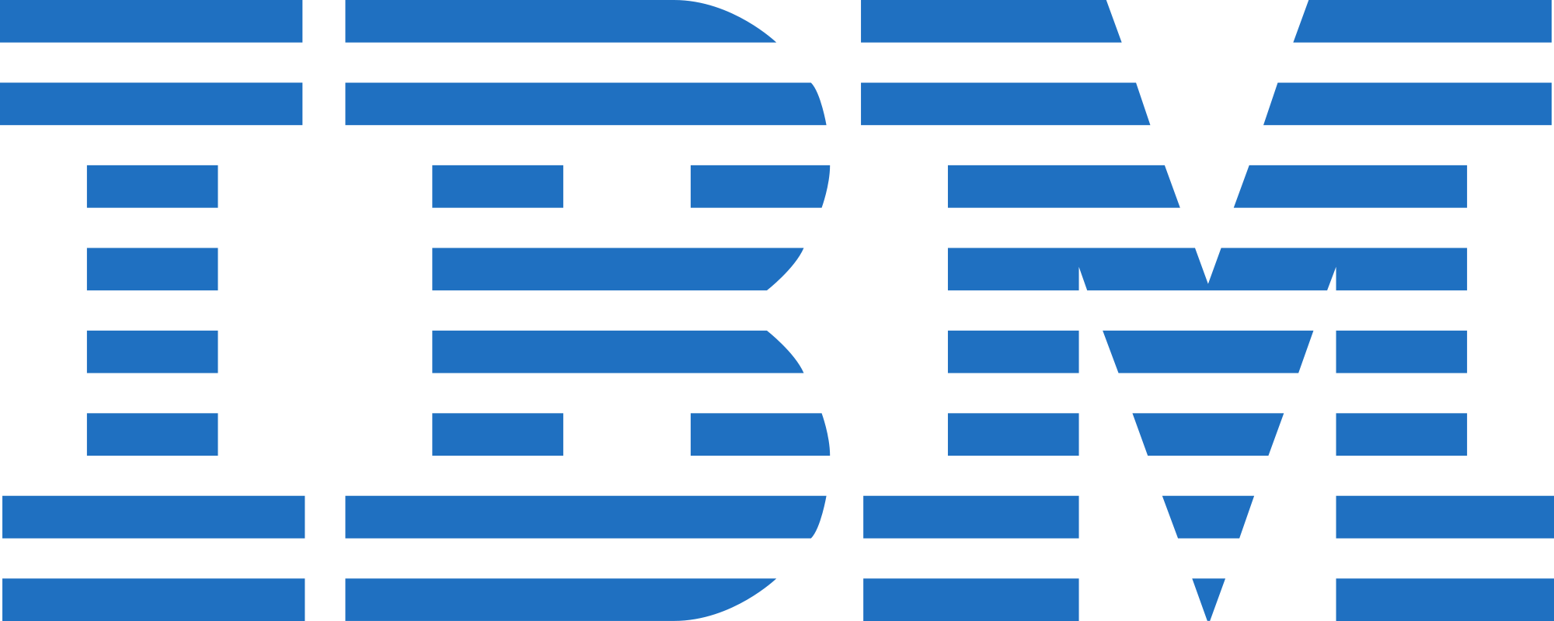









INDUSTRY CONVERGING ON KUBERNETES
Notes:
Community and vendor interest in Kubernetes is huge in the container market and many vendors have adopted Kubernetes within their platforms, sometimes at cost of replacing their own proprietary orchestration, as the standard container orchestration framework.
Platforms
Google: Container Engine
Red Hat: OpenShift
Engine Yard: Deis
Intel: OpenStack on Kubernetes
Apprenda: Apprenda
Apcera: Apcera
VMware: Photon Platform
Walmart: OneOps
Canonical: Kubernetes
CoreOS: Tectonic
Rancher: Rancher
Mesosphere: Enterprise DC/OS
Huawei: Cloud Container Engine
Microsoft: Azure Container Service

Slide 17
BUT WAIT, THERE’S MORE!
Multi-tenancy
Teams and Collaboration
Routing & Load Balancing
Quota Management
CI/CD Pipelines
Image Build Automation
Role-based Authorization
Container Isolation
Capacity Management
Vulnerability Scanning
Infrastructure Visibility
Chargeback
Notes:
Even that still is not enough. There are more capabilities needed to successfully taking these containers to production.

Slide 18

Docker
Kubernetes
Building, Distributing and Running containers at scale
Leading enterprise distribution of Kubernetes
Rapid Application
Deployment
Scaling
Notes:
OpenShift is Red Hat’s container platform based on docker and Kubernetes that brings in all the pieces together
leading enterprise distribution of Kubernetes
optimized for continuous application development and multi-tenant deployment.
adds developer and operational centric tools to enable rapid application development
Provides easy deployment and scaling
Red Hat is a leading contributor to the docker and Kubernetes projects.

Slide 19
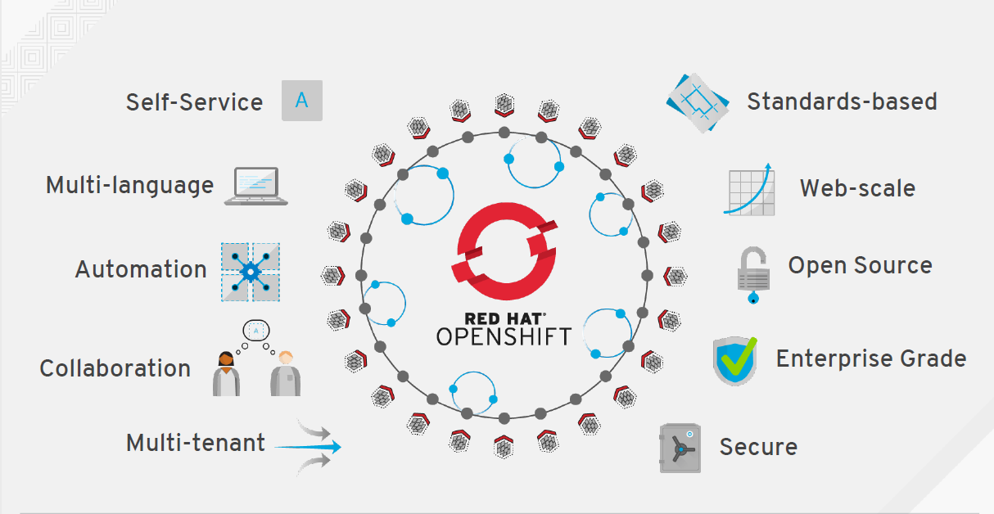

Slide 20

ARCHITECTURE

Slide 21
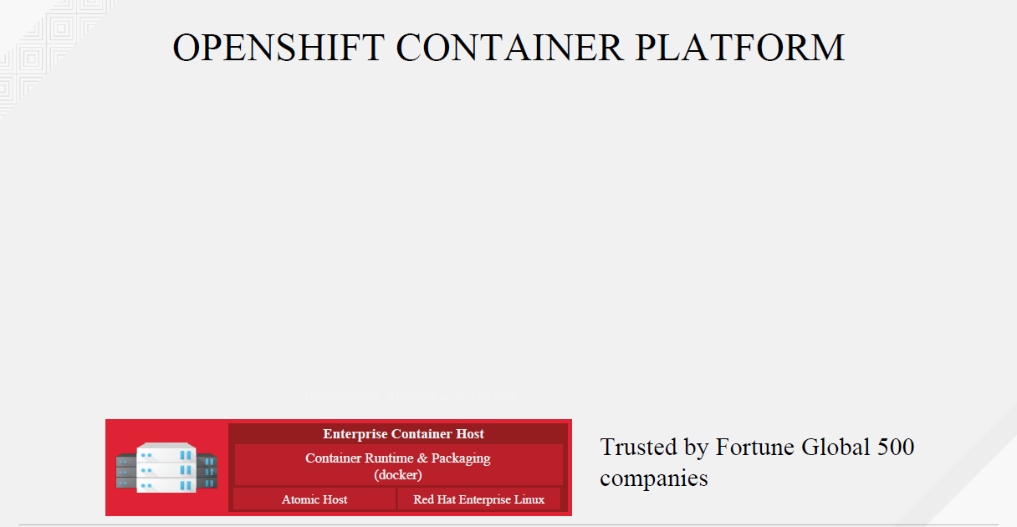

Slide 22
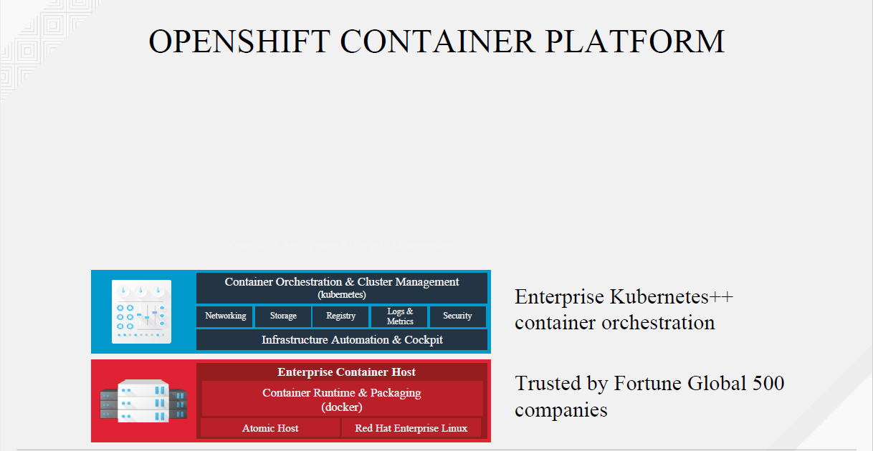

Slide 23
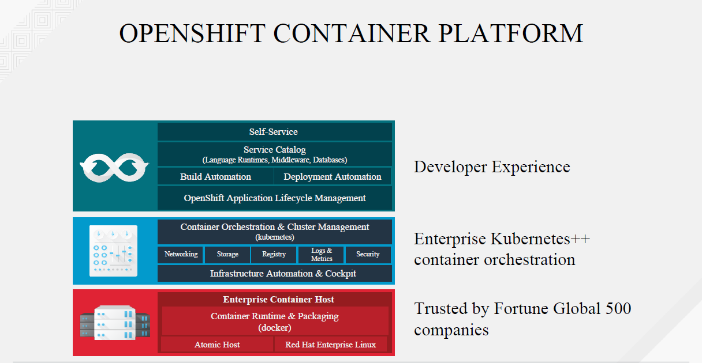

Slide 24
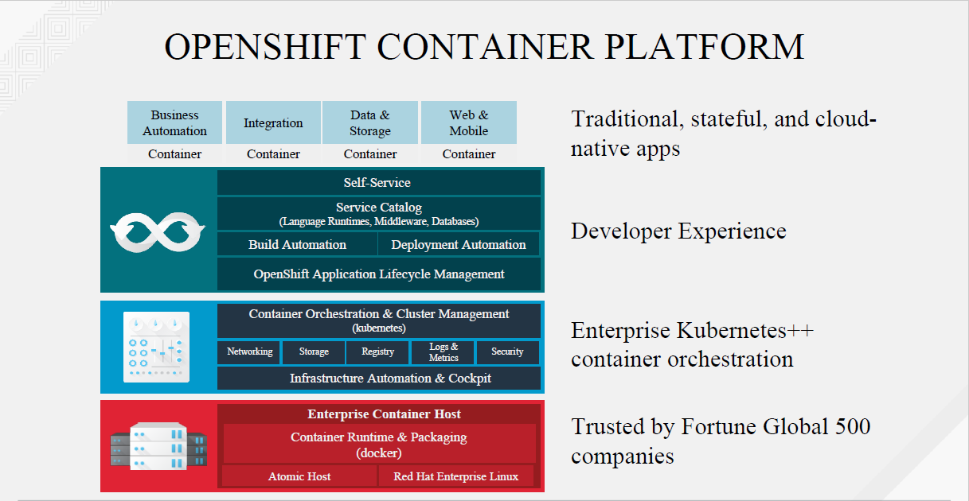

Slide 25
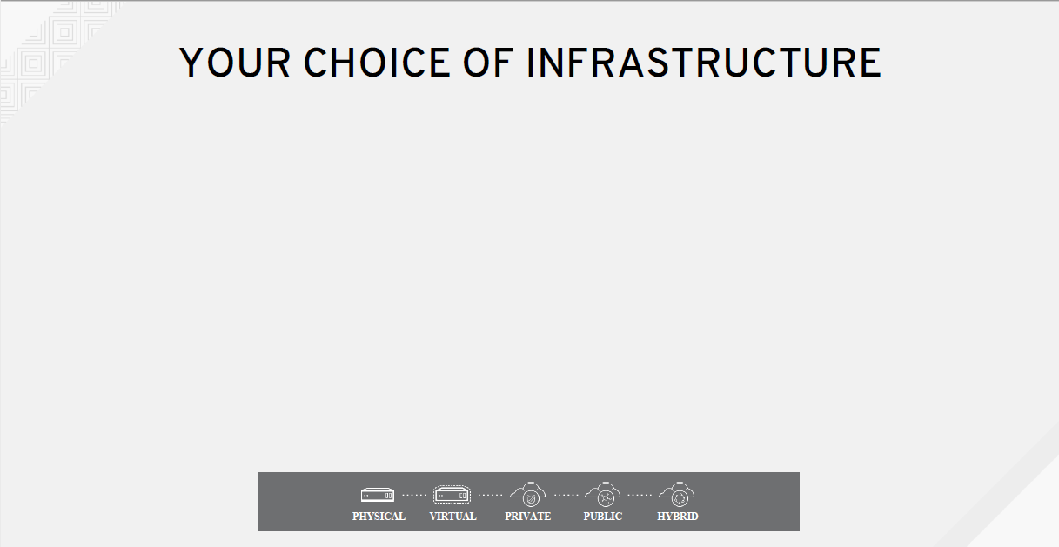

Slide 26
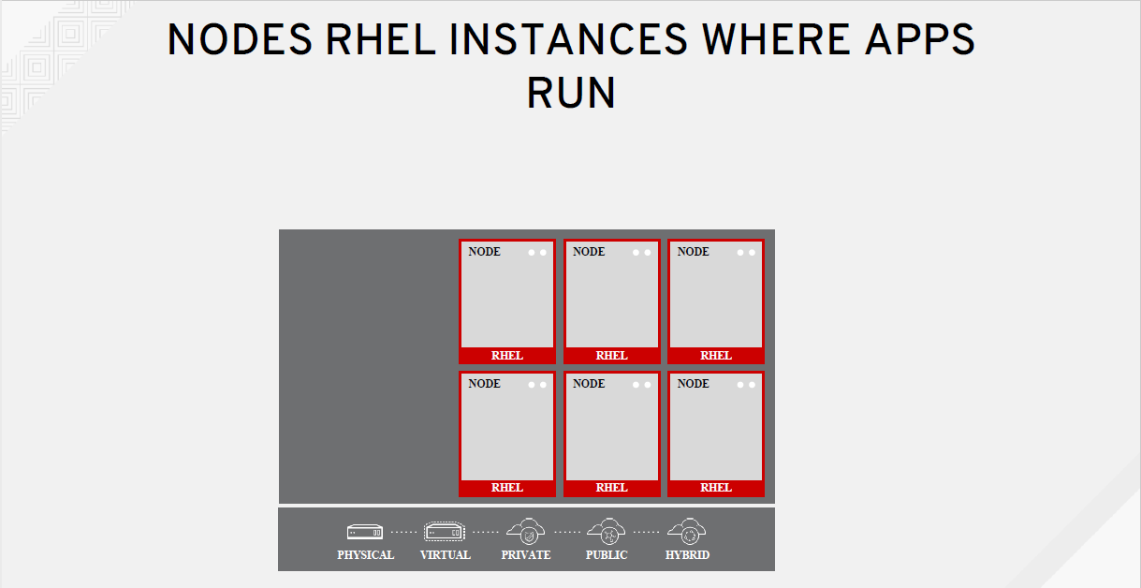

Slide 27
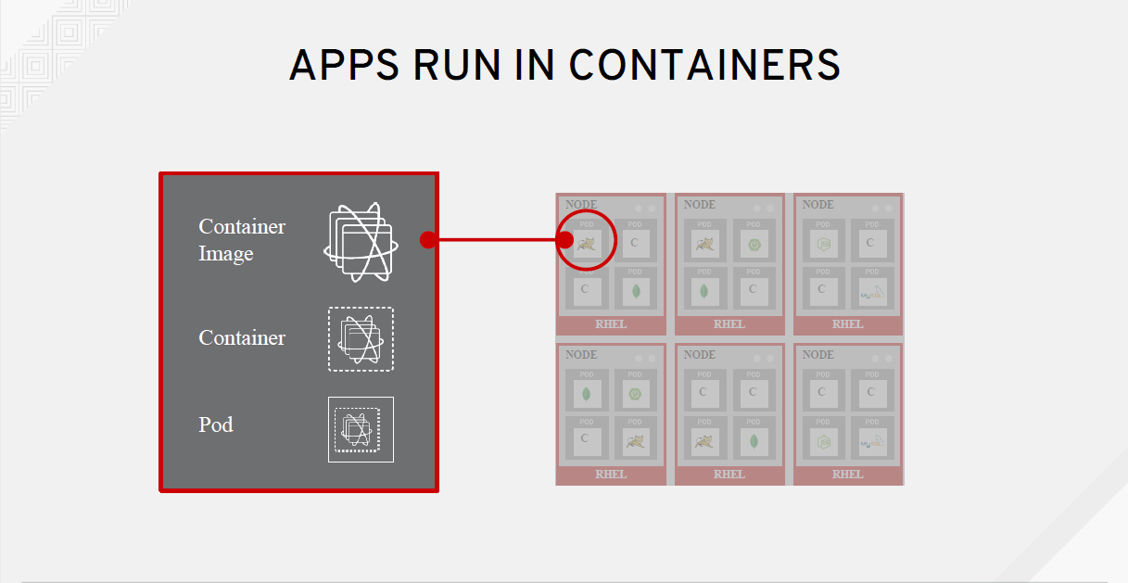

Slide 28
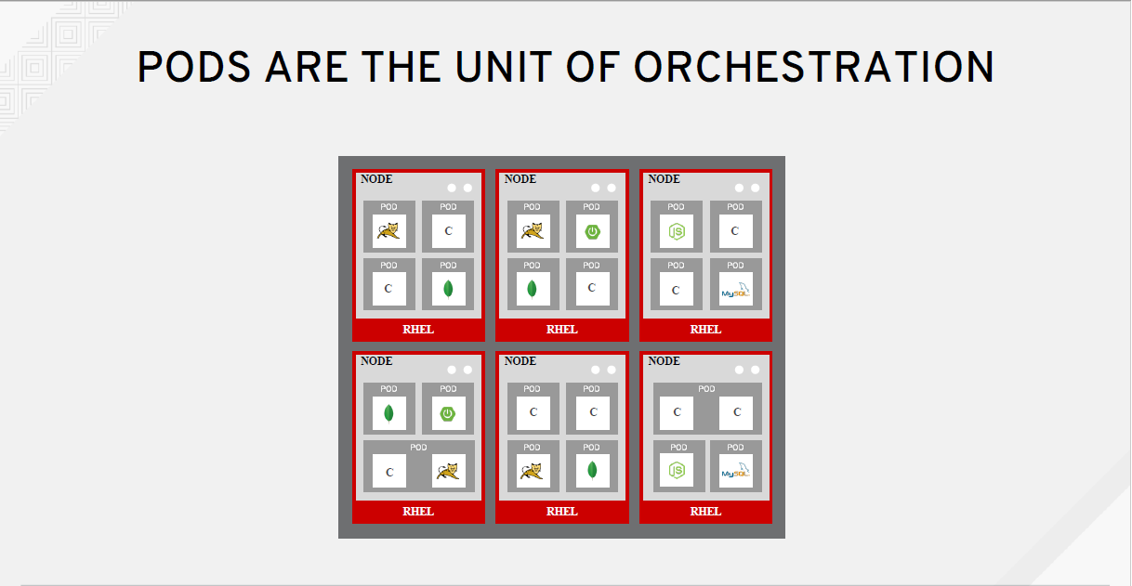

Slide 29
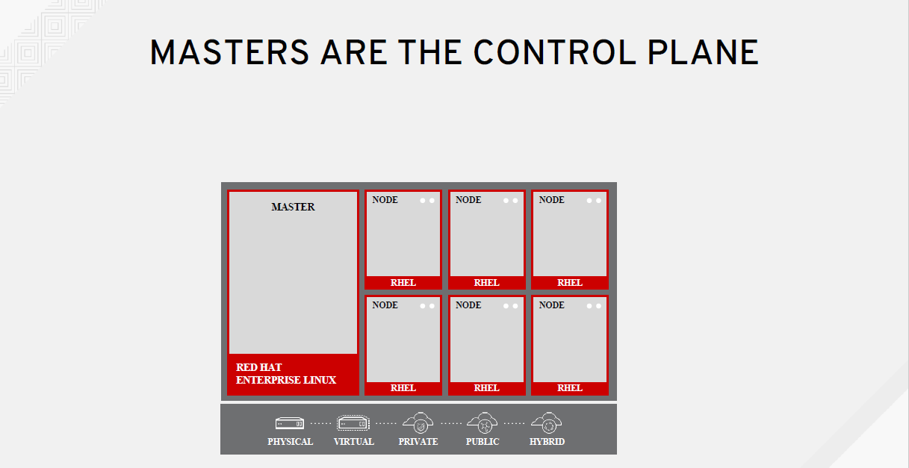

Slide 30
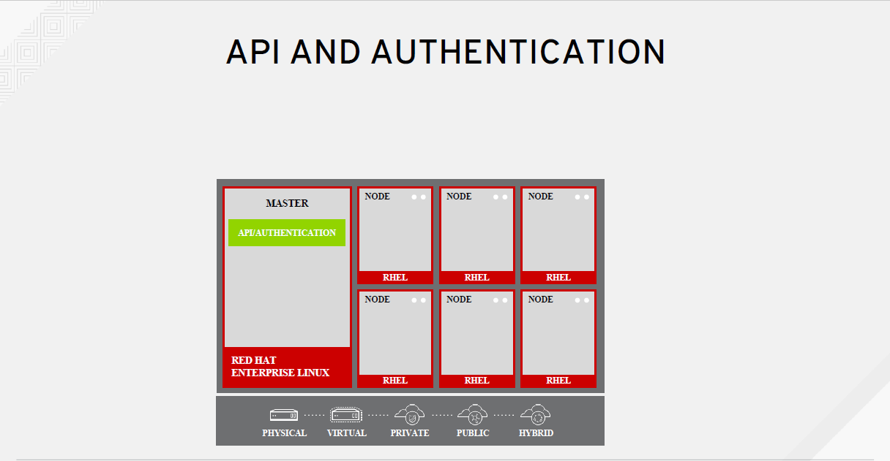

Slide 31
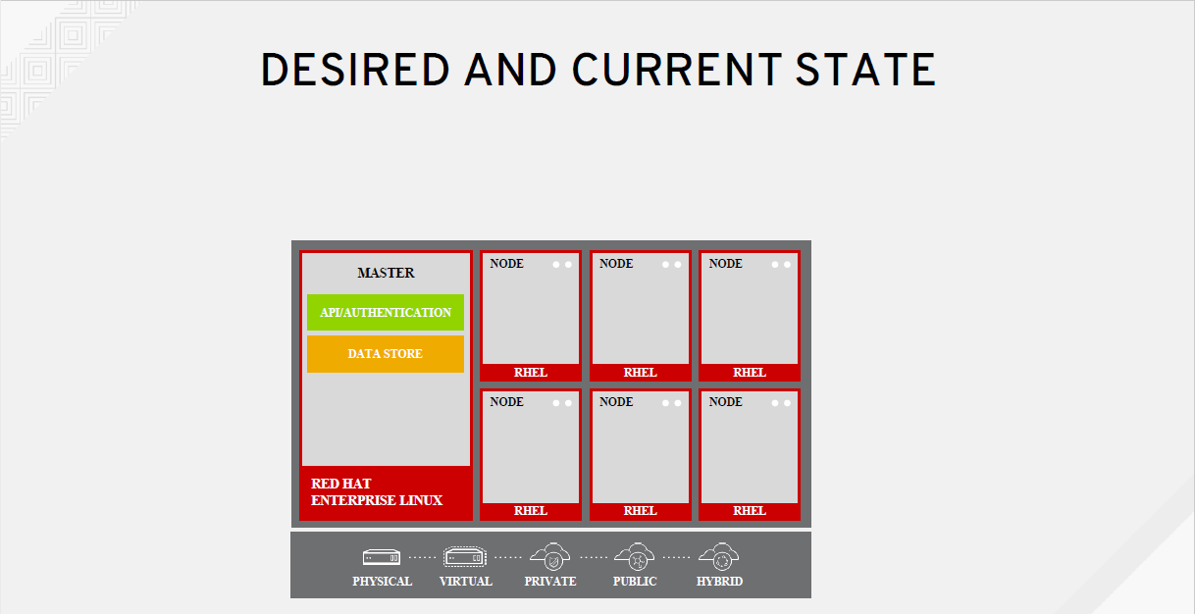

Slide 32
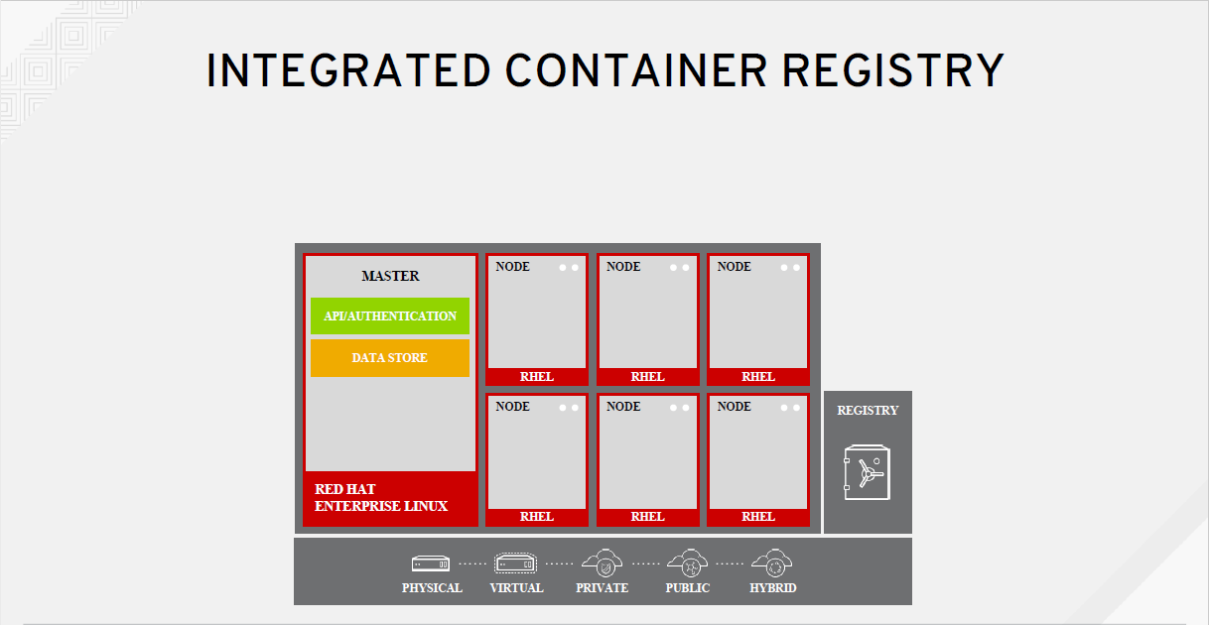

Slide 33
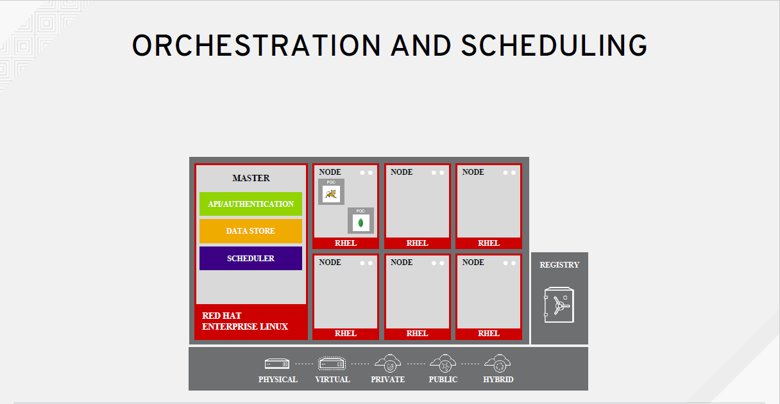

Slide 34
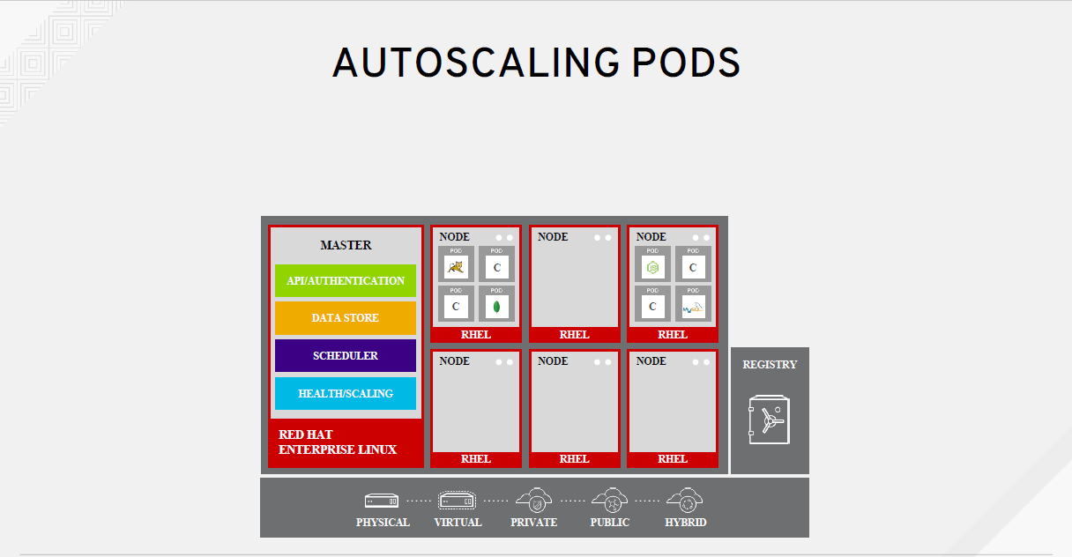

Slide 35
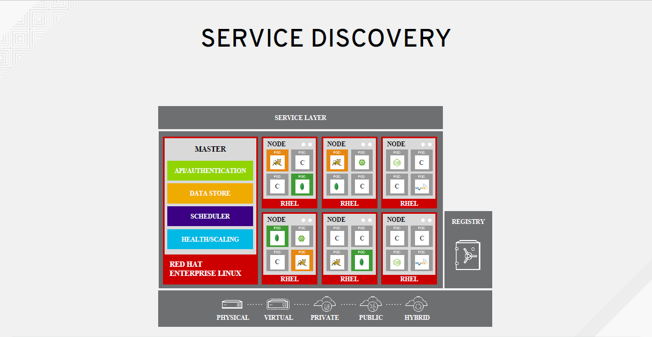

Slide 36
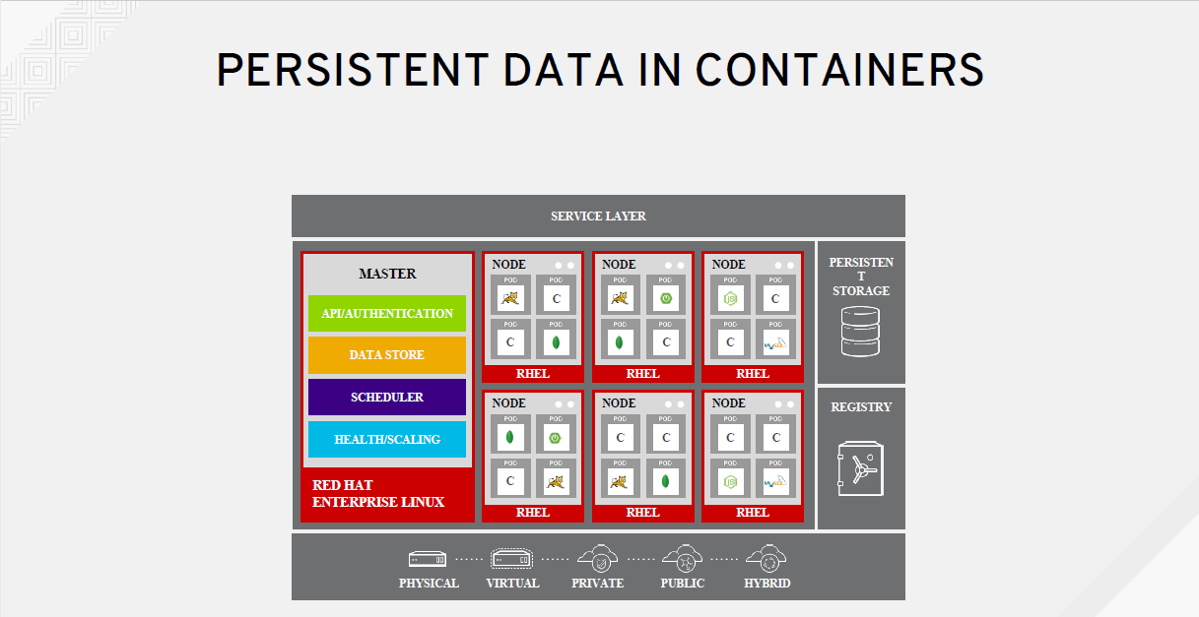

Slide 37
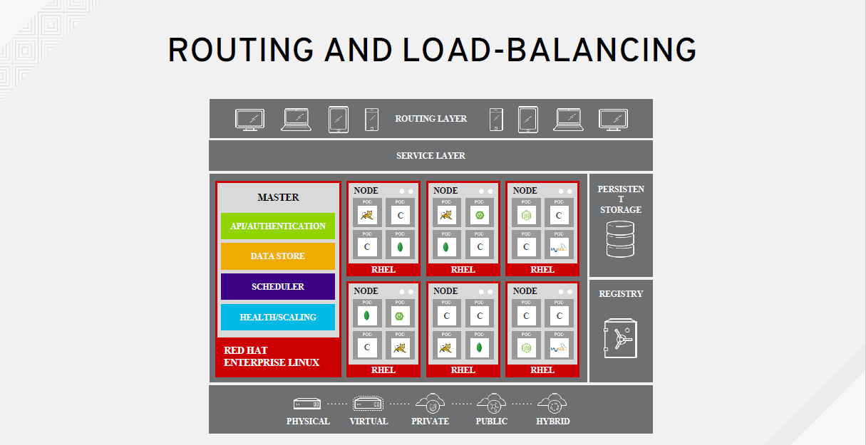

Slide 38


Slide 39
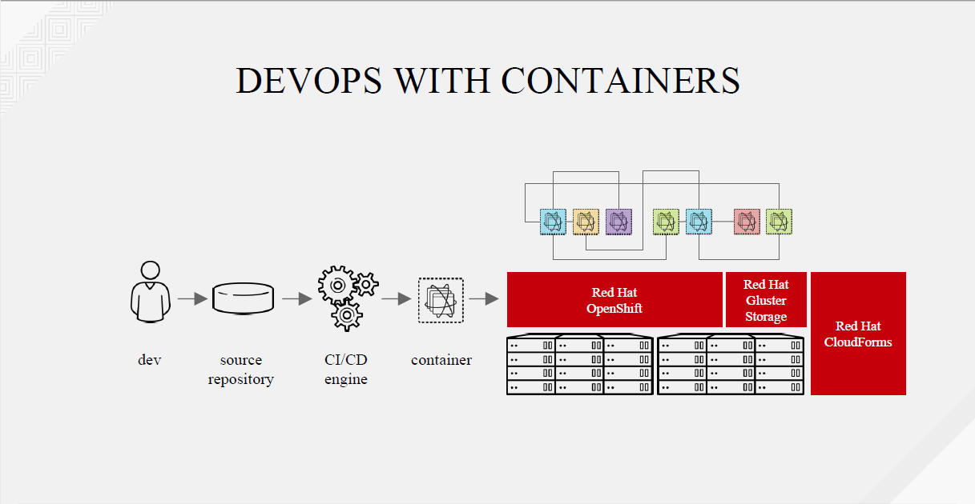

Slide 40
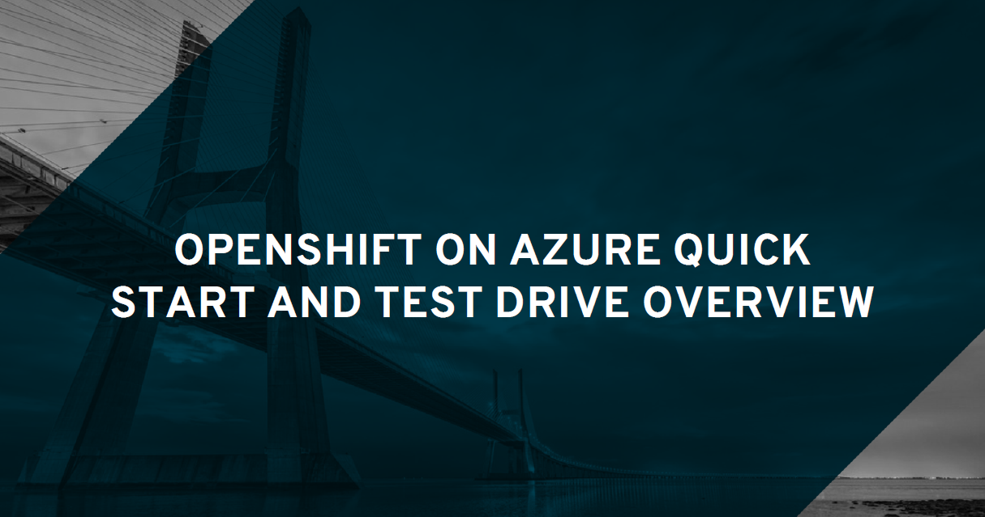

Slide 41
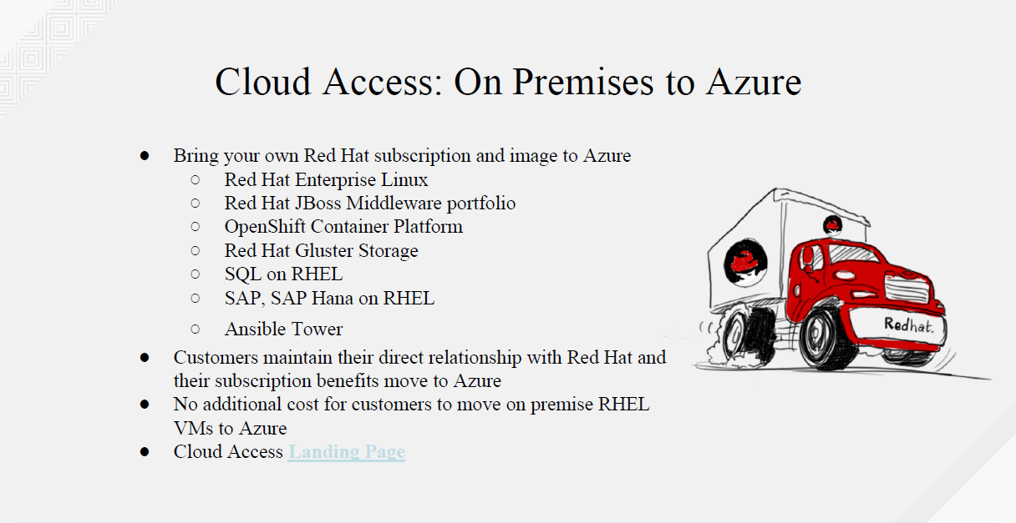

Slide 42
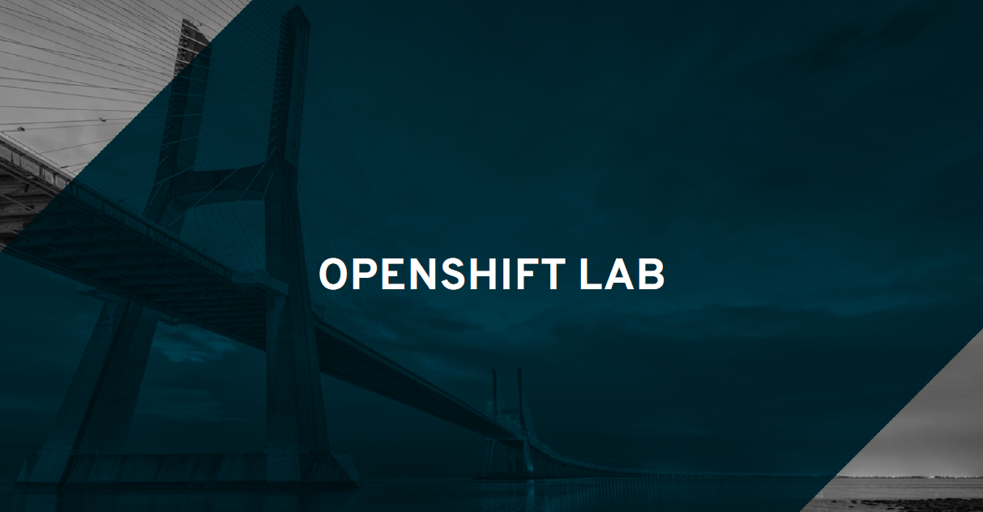

Slide 43
Lab Material
https://github.com/jimgarrett123/openshift_workshop/
OpenShift Console Login
https://master.groupware.openshiftworkshop.com
OC Login
oc login https://master.groupware.openshiftworkshop.com –u <user#>
Password: openshift

Slide 44
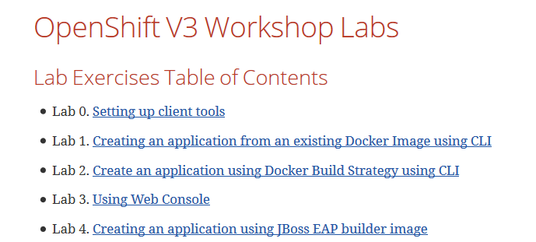
Setting up client tools
Notes:
The information previously conveyed in the Roadshow material may not be accurate.
If attendees have previously installed the Client Tools then they will need to remove the old tool and install the latest version.
The instructions convey how to do this

Slide 45
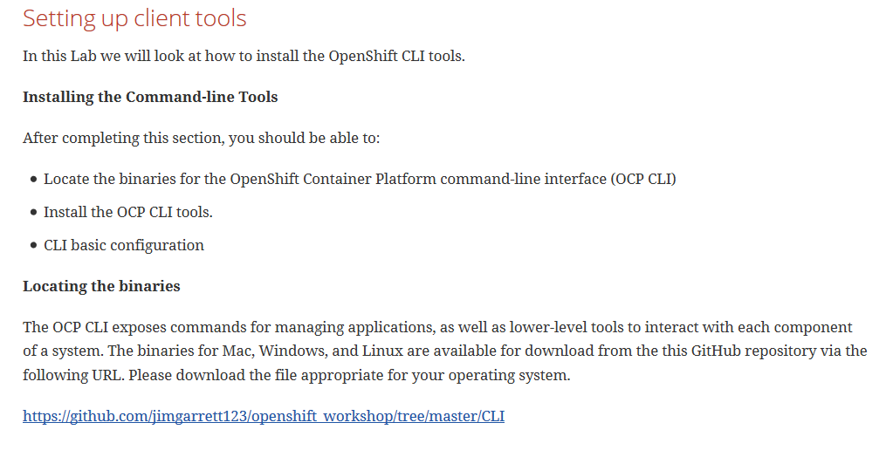
Notes:
Click on the Link to access the latest CLI tools used for this workshop.

Slide 46
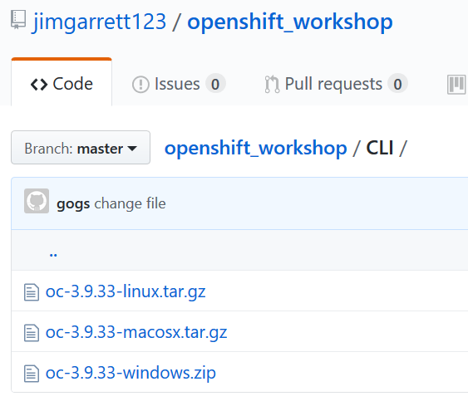

Slide 47
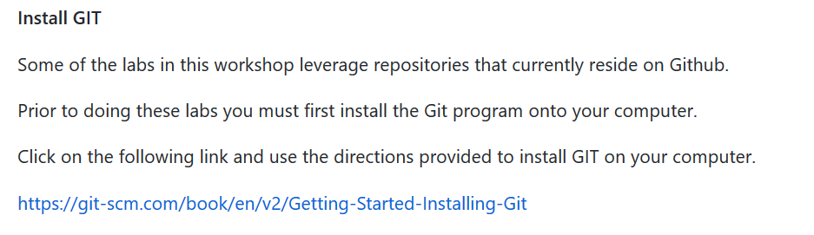

Slide 48
Lab 1: Create an App from a Docker Image
Step 1: Add a new project from the command line
$ oc new-project mycliproject-UserName --description="My CLI Project" --display-name="CLI Project“
Step 2: Create an application from a Docker Image
$ oc new-app redhatworkshops/welcome-php --name=welcome
*
*
*
Step 4: Try your application
Notes:
Step 1: creates a new project in your Openshift environment.
Step 2: creates an application from an existing Docker Image. The Image is pulled from the DockerHub.

Slide 49
Create Application
Create an application based on an image from Docker Hub (https://hub.docker.com) :
$ oc new-app redhatworkshops/welcome-php --name=welcome
Create an application based on an image from a private registry:
$ oc new-app --docker-image=myregistry.com/mycompany/myapp --name=myapp
Create an application based on source code stored in a Git repository:
$ oc new-app https://github.com/openshift/ruby-hello-world --name=ruby-hello
Notes:
There are multiple ways to create an application.
Examples include:
Create application based on image from Docker Hub
Create application based on image from private registry
Create application based on source code in repository

Slide 50
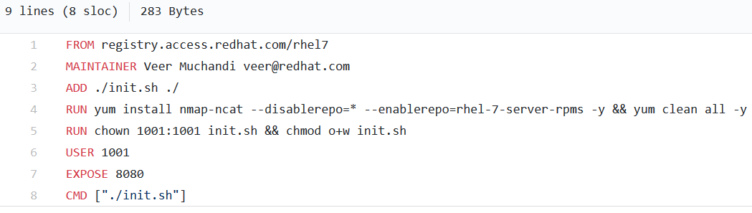
Lab 2: Create an App using Docker Build
Notes:
Applications can be added to Openshift by using an existing Dockerfile containing instructions on how to build the image.
In the Dockerfile above you can see where Docker pulls the initial image from “registry.access.redhat.com/rhel7”. This will create the base image containing the RHEL 7 operating system.
Line 3 shows where a file, init.sh, is added to the image
Line 4 enables a repository and adds several modules
.
.
Line 8 starts the image by processing he init.sh shell script

Slide 51
Lab 3: Using the Web Console
In this lab exercise, we will review the OpenShift Web Console.

Slide 52
Lab 4: Creating an application using JBoss EAP builder image
Learn how to create an application using source code and the JBoss EAP builder image.
The EAP builder image:
Found in a Github source code repository
Contains source code tree formatted to match JBoss EAP

Slide 53
Lab 5: Use a Template to provision a container
Out of the box Openshift contains a registry of existing container templates that can be use to provision new containers.
In this workshop you will use existing templates to provision a MySql database and a PHP application.

Slide 54
Lab 6: Scale Application Instances Up/Down
One of the features provided by Openshift is the ability to dynamically scale the number of container instances (in pods) up/down.
In this lab you will experiment with this feature.

Slide 55
Lab 7: Binary Deployment of a WAR file
In this exercise you will learn to deploy a war file. We will assume that you built your source code outside of OpenShift build process and want to download the WAR file on your workstation.

Slide 56
Lab 8: How to configure SSL
In this exercise you will set up your application to encrypt traffic with the OpenShift Wildcard certificate.

Slide 57
Lab 9: Blue Green Deployments
Blue-green deployment is a release strategy that can be utilized by developers for deploying software in a production environment. Blue can be one particular production environment whereas green can define an identical production environment. Under blue-green deployment strategy, software developers are able to minimize downtime and reduce risk.
In this Lab, we will be:
Deploying two versions of the same application.
The first version will display a blue rectangle.
The second version will displays a green rectangle.
We will then switch the FQDN from the first application (blue) to the second application (green).

Slide 58
Lab 10: SCM Web Hooks
What is a WEB HOOK?
A Webhook is a lightweight configurable tool, that allows you to easily create HTTP endpoints (hooks) on your server, which you can use to execute configured commands when changes in source code are detected.
Provides mechanism to initiate CI/CD when source code changes.

Slide 59
Lab 11: Rollback Applications
In this lab we will see how we can rollback an application in OpenShift quickly without switching to an older version of the source code in SCM.
Why is this important? What function does this provide?

Slide 60
Lab 12: Code Promotion Across Environments
In this lab we will learn how an application image binary can be promoted across the environments.
As an example we will use development and QA environments.

Slide 61
Lab 13: Changing Code on the Fly
In this lab, we will learn how to make changes to the code on the local machine and immediately sync it with the code running in a pod.
This lab is analogous to what a developer would encounter when developing and changing his code that is then deployed to a container.

Slide 62
Lab 14: Creating a Pipeline
What is a BUILD PIPELINE?
A Build Pipeline is a process for getting software from version control into the hands of your users.
That process involves building the software, followed by the progress of the build through multiple stages of testing and deployment.
The build pipeline allows you to see the progress of each change as it moves from version control through various sets of tests and deployments to release to users.

Slide 63
Lab 15:Using .NET and PostgreSQL Template
In this lab exercise we will learn how to use OpenShift Web Console to spin up a PostgreSQL database and .Net application using templates.

Slide 64
THANK YOU
plus.google.com/+RedHat
facebook.com/redhatinc
linkedin.com/company/red-hat
twitter.com/RedHatNews
youtube.com/user/RedHatVideos

